Slide 1

Measure Of Central Tendency
Nazmul Kader Chowdhury
Lecturer , PCIU

Slide 2
There are four characteristics of a data set or a frequency distribution. They are
Location or central tendency
Dispersion
Skewness
Kurtosis

Slide 3
Central Tendency
In statistics, the central tendency is the descriptive summary of a data set. Through the single value from the dataset, it reflects the centre of the data distribution. Moreover, it does not provide information regarding individual data from the dataset, where it gives a summary of the dataset. Generally, the central tendency of a dataset can be defined using some of the measures in statistics.
Definition
The central tendency is stated as the statistical measure that represents the single value of the entire distribution or a dataset. It aims to provide an accurate description of the entire data in the distribution.

Slide 4
Measures of Central Tendency
Measures that indicate the approximate center of a distribution are called measures of central tendency.

Slide 5
Some Definitions
Simpson and Kafka defined it as “ A measure of central tendency is a typical value around which other figures gather”
Waugh has expressed “An average stand for the whole group of which it forms a part yet represents the whole”.
In layman’s term, a measure of central tendency is an AVERAGE. It is a single number of value which can be considered typical in a set of data as a whole.

Slide 6
Characteristics of a Good Measure of Central Tendency
It should be easy to understand
It should be easy to compute
It should be rigidly defined. This says that, the series of whose average is calculated should have only one interpretation. One interpretation will avoid personal prejudice or bias.
It should be based on all observations. In other wards, the value should lie between the upper and lower limit of the data.
It should be capable of further algebraic treatment. In other wards, an ideal average is one which can be used for further statistical calculations.
It should have sampling stability
It should not be affected by the presence of extreme values

Slide 7
The following frequency distribution refers to the number of hours worked per month of 50 workers of a factory. Compute mean, median, mode.
No. of hours worked per month
Frequency
No. of hours worked per month
Frequency
No. of hours worked per month | Frequency
30-55 | 3
55-80 | 4
80-105 | 6
105-130 | 9
130-155 | 12
155-180 | 11
180-205 | 5

Slide 8
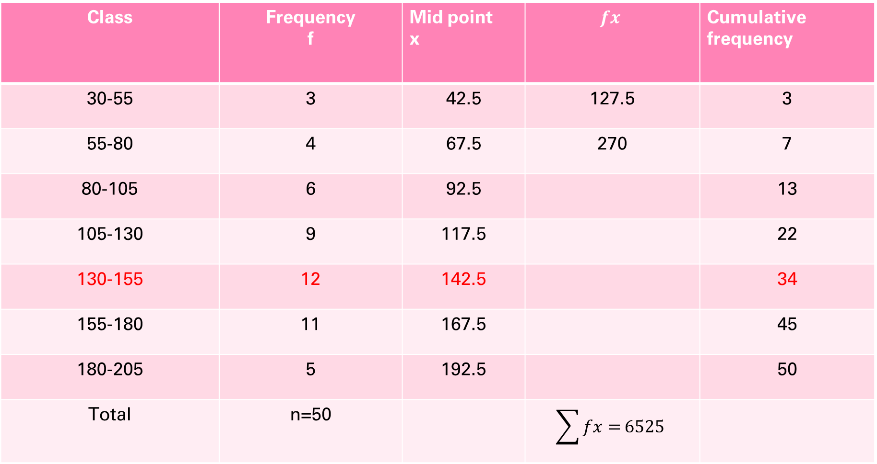
Solution:
Class | Frequency f | Mid point x | $$fx$$ | Cumulative frequency
30-55 | 3 | 42.5 | 127.5 | 3
55-80 | 4 | 67.5 | 270 | 7
80-105 | 6 | 92.5 |  | 13
105-130 | 9 | 117.5 |  | 22
130-155 | 12 | 142.5 |  | 34
155-180 | 11 | 167.5 |  | 45
180-205 | 5 | 192.5 |  | 50
Total | n=50 |  | $$\sum{fx=}6525$$

Slide 9
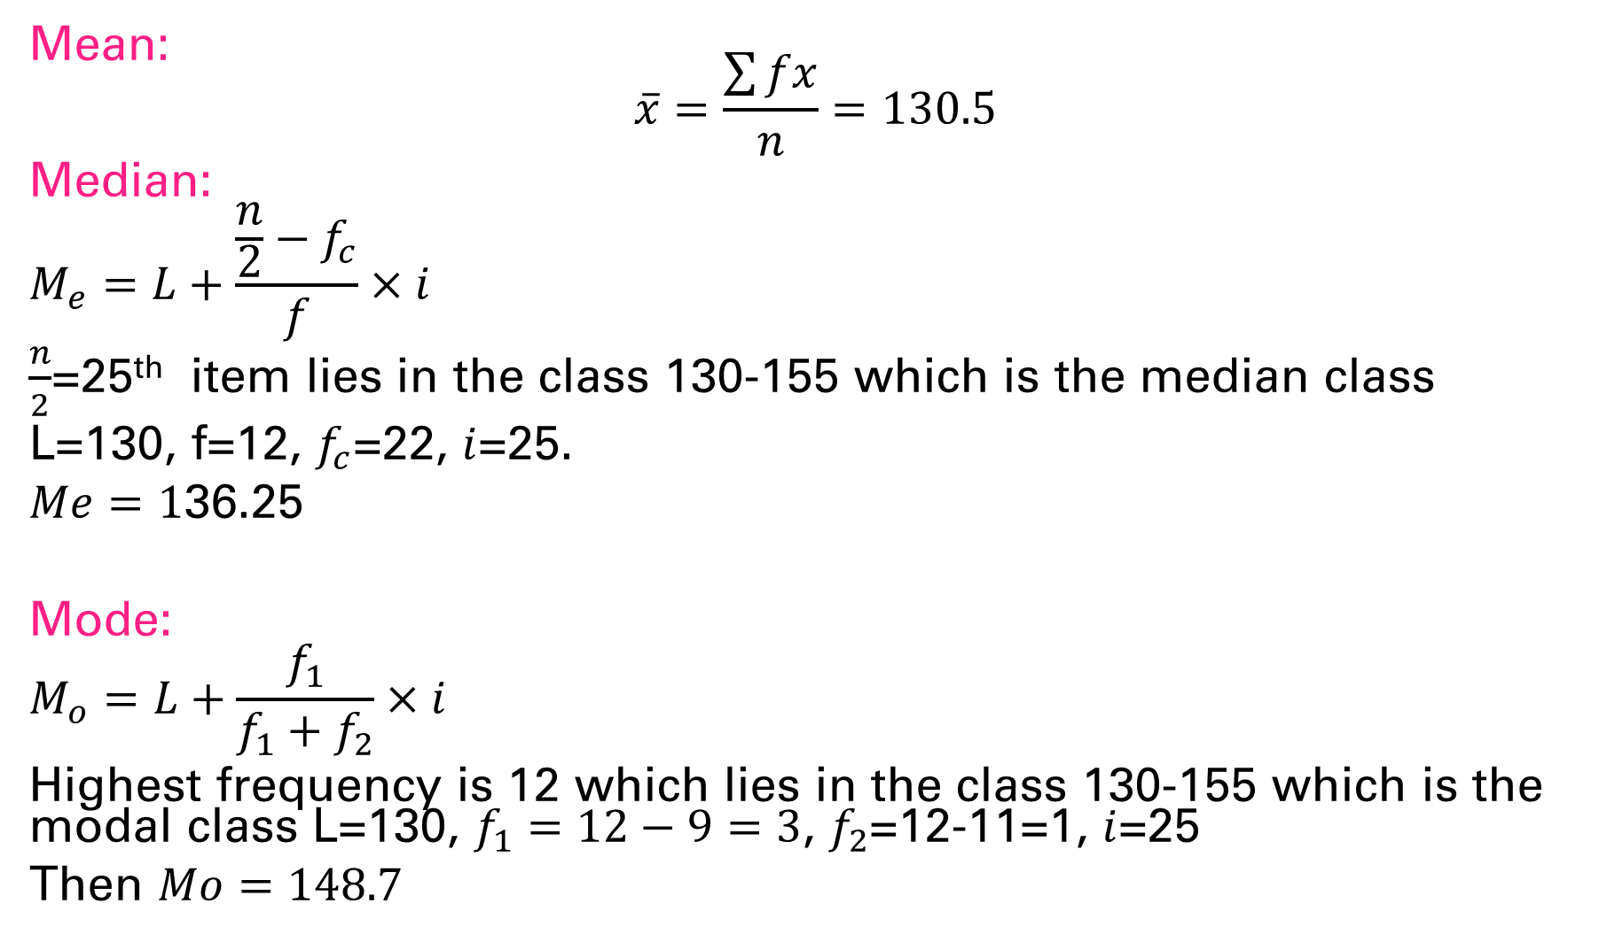
Mean: $$\overline{x}=\frac{\sum{fx}}{n}=130.5$$
Median:
$$M_{e}=L+\frac{\frac{n}{2}−f_{c}}{f}×i$$
$\frac{n}{2}$=25th item lies in the class 130-155 which is the median class
L=130, f=12, $f_{c}$=22, $i$=25.
$Me=1$36.25
Mode:
$$M_{o}=L+\frac{f_{1}}{f_{1}+f_{2}}×i$$
Highest frequency is 12 which lies in the class 130-155 which is the modal class L=130, $f_{1}=12−9=3$, $f_{2}$=12-11=1, $i$=25
Then $Mo=148.7$

